Slide 1

Data Carpentry: Data Skills Training to Enable More Effective & Reproducible Research
Tracy K. Teal, PhD
Data Carpentry
Executive Director
@datacarpentry @tracykteal
http://www.datacarpentry.org
Notes:
Strategies and Techniques for Analyzing Microbial Population Structure
Explorations in Data Analyses for Metagenomic Advances in Microbial Ecology

Slide 2
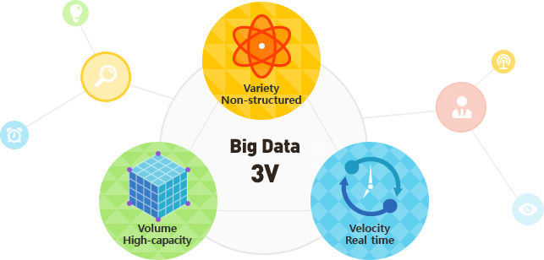
Our increasing capacity to collect data is changing research
Notes:
Our increasing capacity to collect data is changing science.
In the last 5 years, more scientific data has been generated than in the entire history of mankind, and this trend towards more data production is not slowing down.

Slide 3
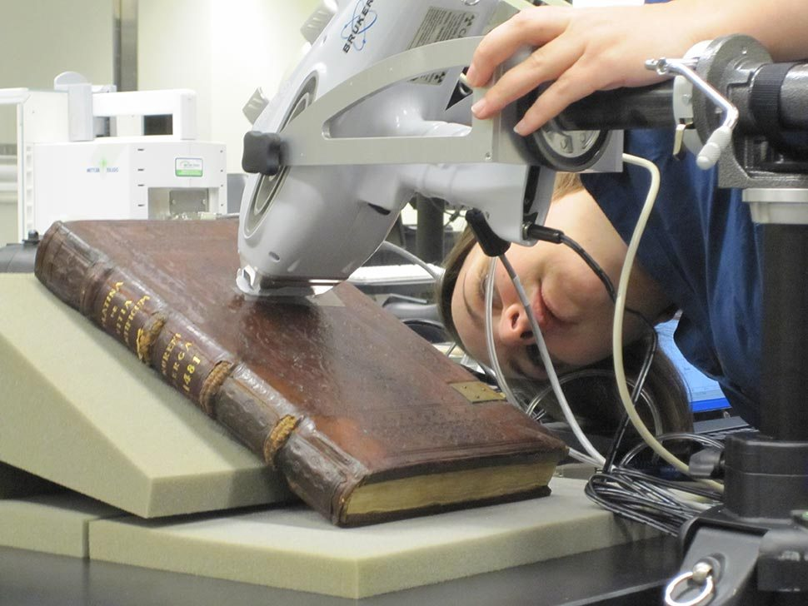
Data production is no longer the bottleneck
Notes:
Our increasing capacity to collect data is changing science. This is particularly true in genomics where, with high-throughput sequencing, data production is no longer a bottleneck.
Again, these plots keep increasing with technologies like NanoPore coming in to wider use, and we can only imagine what the next technologies will be.
This isn’t only genomics data either, there’s also all the ‘omics along with high throughput phenotype screening, imaging and even environmental data. And ideally we’d like to be able to integrate these different datasets.

Slide 4
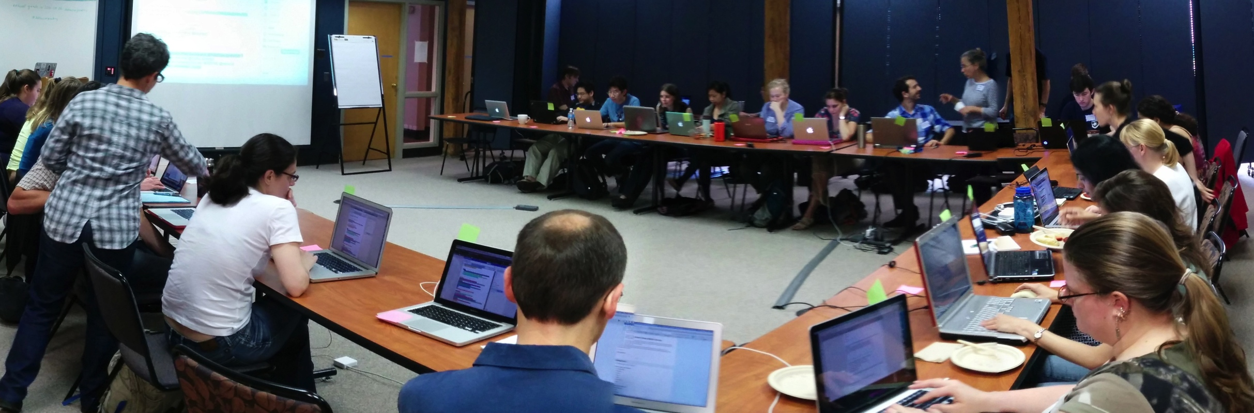
Working with ‘big data’ is no longer the domain of specialists and is instead widely done by all researchers.
Notes:
Lack of expertise was identified as the single biggest difficulty facing researchers in their bioinformatics activities, and training as the most valuable thing that BRAEMBL could do to support those activities.”

Slide 5


Data pain
Notes:
Once you get the data back though, often instead of being seen as an exciting opportunity, it’s seen as an insurmountable challenge how to manage, store, analyze or even view the data.

Slide 6
How do we scale ‘data literacy’ along with data production?
Notes:
However data is not information or scientific insight on its own and we need to unlock the potential of that data – some of that is tools and software, databases and infrastructure. But the key to that is the researchers themselves and their ability to conduct this research and good practice around data management and analysis and the software development to analyze this data.

Slide 7

Training is a missing piece between data collection & data-driven discovery
Training
Notes:
Researchers need to be trained in how to effectively manage and use this data. Researchers don’t know how to address the questions they want to ask or aren’t even aware of the types of questions they can ask with this data.
Story about genomics researcher
It’s no longer the case where we’re saying ‘researchers should’. Researcher themselves want this training, feel limited by their own current data analysis skills. You likely have anecdotal evidence of this in your own community or domain

Slide 8
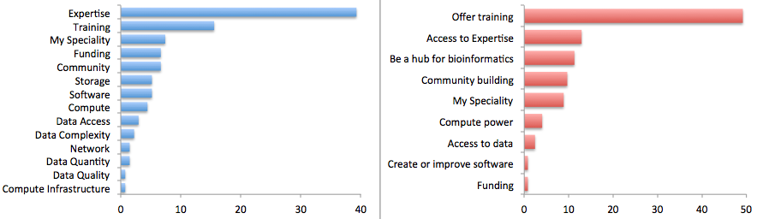
Researchers view the major limiting factor in research progress as a lack of expertise in how to handle and analyze data
Survey by Bioinformatics Resource Australia – EMBL
Biggest Bioinformatics Difficulty
Most useful thing BRAEMBL could do
http://braembl.org.au/news/braembl-community-survey-report-2013
Notes:
, but for instance …
Biomedical researchers in the UK had similar sentiments in a survey
https://storify.com/biocrusoe/elixir-uk-node-meeting-2014-10-14
And an internal study at PLOS showed a lack of data management expertise has a dramatic impact on the ability
of researchers to share their data

Slide 9
Where does this training come from?
Notes:
Curriculum is full. Not enough teachers at universities with these skills. Short courses are over subscribed.

Slide 10


Data Carpentry develops and runs workshops to fill that training gap
Notes:
Our goal is to provide researchers high-quality, domain-specific training covering the fundamentals and best practices in the full lifecycle of data-driven research.

Slide 11
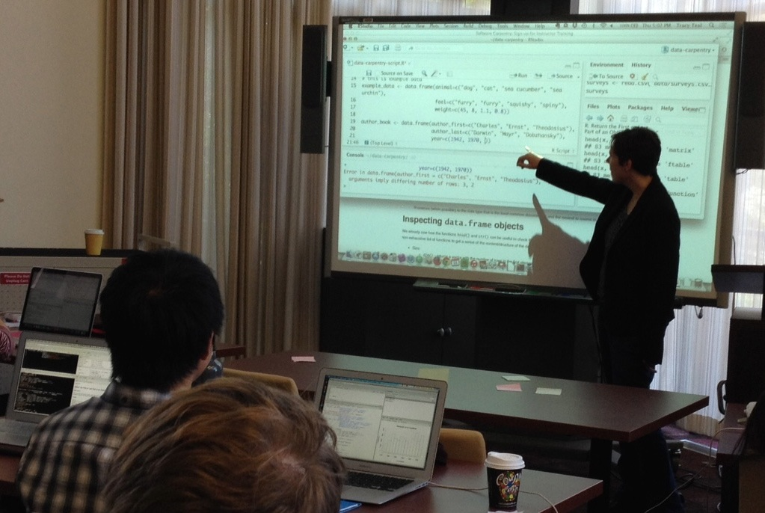
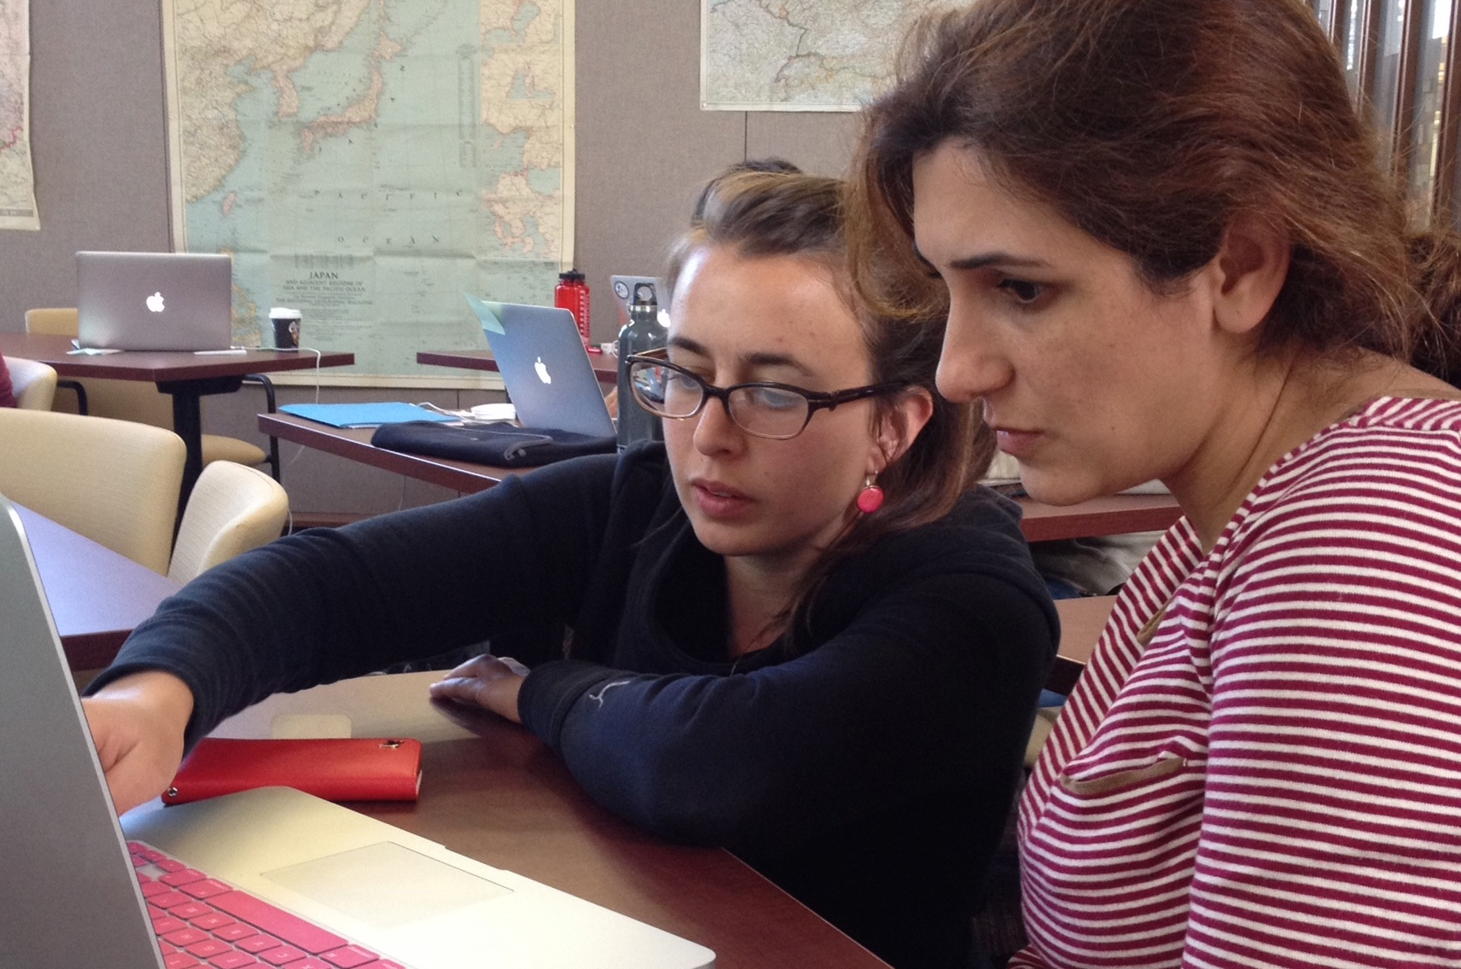
Develop and run two-day hands-on interactive workshops.
Teach basic concepts, skills and tools for working more effectively and reproducibly with data.

Slide 12
Workshops
For people with little to no prior computational experience
Domain specific
Follow a narrative structure
Intro to the data type
Data & project organization
Data analysis & visualization
Data management
Data cleaning

Slide 13
Workshops
Focused on better scientific programming practices, for writing software or analysis scripts
Novice and more advanced levels
Domain agnostic
Curriculum
Command line
Software development best practices in R, Python or MATLAB
Github for version control

Slide 14
Grassroots training effort
Developed by practitioners for practitioners
Researchers identify skills and best practices needed in data management and analysis in given domains
Training materials developed collaboratively and openly licensed
Workshops taught by volunteer helpers and instructors
Notes:
Deliverables are lessons and workshops

Slide 15
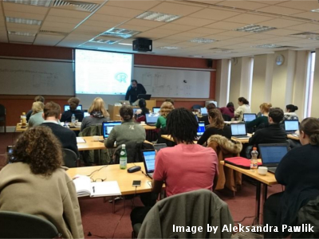
Hands-on intensive workshops
Two days
Hands-on
Qualified instructors
Helpers
Post-it notes!
Friendly learning environment
We can’t teach everything in two days, but the goal is to teach foundational skills to reduce the activation energy for getting started and to know what’s possible.

Slide 16
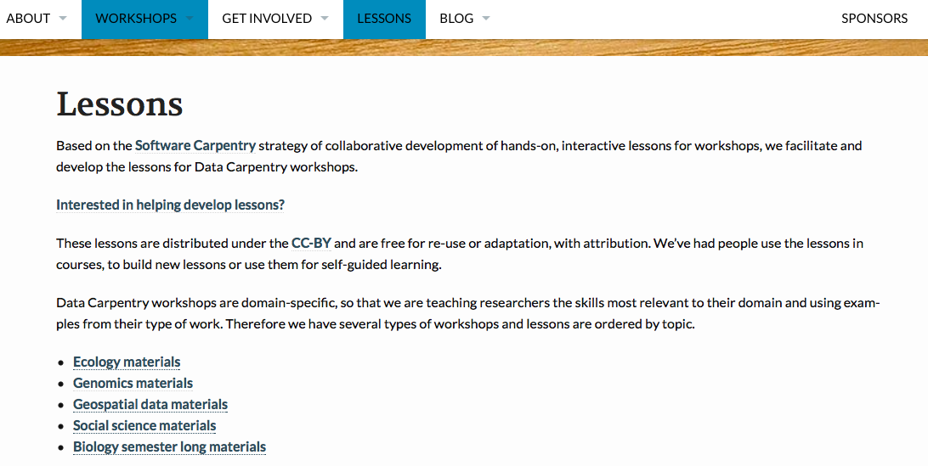
Collaboratively developed curriculum
http://www.datacarpentry.org/lessons/

Slide 17
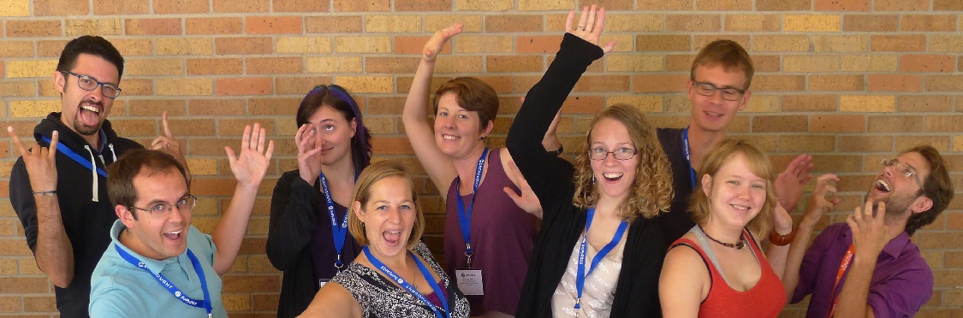
Volunteer instructors
The Software Carpentry Foundation runs the Instructor Training program that teaches volunteers teaching pedagogy and specific strategies for teaching computational skills in a workshop format.

Slide 18
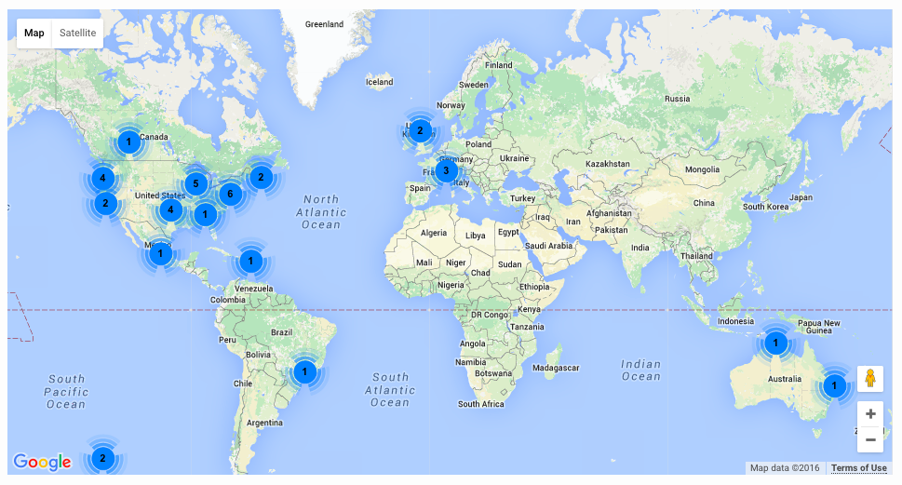
Workshops Worldwide
Since 2014:
Over 300 two-day workshops
Over 9000 learners
Taught by over 200 volunteers
In over 20 countries
Notes:
Materials and workshop model founded on successful SWC model
Workshops fill gaps
Demand continues to grow with a minimum of two workshops a week already scheduled in 2016

Slide 19
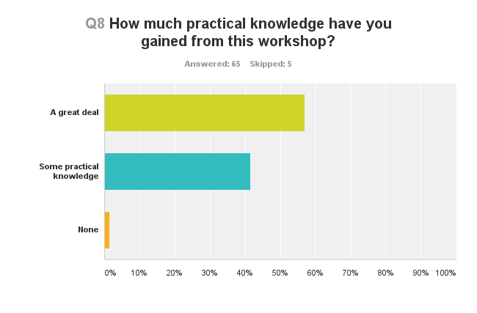
People are learning things

Slide 20
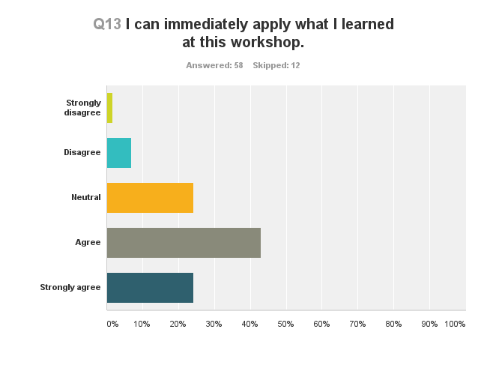
They feel the workshop was worthwhile

Slide 21
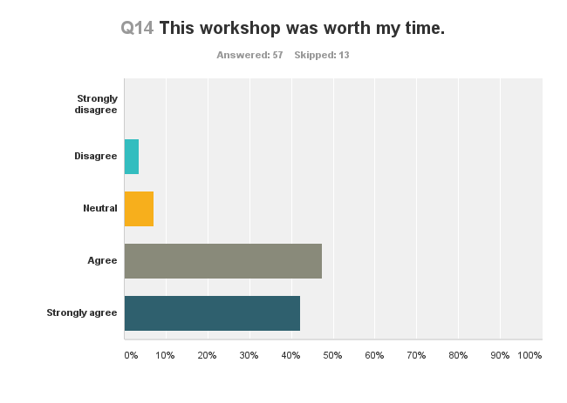
They feel the workshop was worthwhile

Slide 22
Social Sciences
Tabular data
Text mining
Materials for Psychology with Center for Open Science

Slide 23
Get Involved
Request a workshop
Be a helper at a workshop
Become a partner or affiliate and train local instructors
Contribute to lesson development

Slide 24
Guiding the Carpentries
Software Carpentry Steering Committee:
Matt Davis (Bay area company)
Adina Howe (Iowa State)
Katy Huff (UC Berkeley)
Karin Lagenstrom (Norway)
Aleksandra Pawlik (Software Sustainability Institute)
Raniere Silva (Brazil)
Jason Williams (CSHL)
Data Carpentry Steering Committee:
Karen Cranston (NESCent / OpenTree of Life)
Hilmar Lapp (NESCent / Duke)
Aleksandra Pawlik (Software Sustainability Institute)
Karthik Ram (rOpenSci / Berkeley Institute of Data Science Fellow)
Ethan White (University of Florida / Moore DDD Investigator)
Greg Wilson (Software Carpentry)
Notes:
Truly collaborative effort

Slide 25







Support
Data Carpentry
Software Carpentry
http://software-carpentry.org/scf/partners/

